Slide 1
Notations
UML Class Diagrams

Slide 2
Outline
some common design exercises
introduction to UML
UML class diagrams: syntax and examples
some class diagram software tools
class diagram example exercise

Slide 3
Design phase
design: specifying the structure of how a software system will be written and function, without actually writing the complete implementation
a transition from "what" the system must do, to "how" the system will do it
  What classes will we need to implement a system that meets our requirements?
  What fields and methods will each class have?
  How will the classes interact with each other?

Slide 4
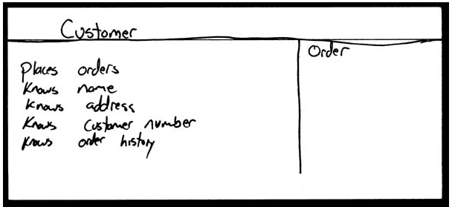
How do we design classes?
class identification from project spec / requirements
  nouns are potential classes, objects, fields
  verbs are potential methods or responsibilities of a class
CRC card exercises
  write down classes' names on index cards
  next to each class, list the following:
    responsibilities: problems to be solved; short verb phrases
    collaborators: other classes that are sent messages by this class (asymmetric)
UML diagrams
  class diagrams (today)
  ...

Slide 5
Class design exercise
Consider the following system: We want to write software for a Texas Hold 'em poker game in Java. The game will have a graphical user interface. The game allows 2 to 8 human or computer players. Each player has a name and a stack of chips representing their money. Computer players also each have a difficulty setting of easy, medium, or hard.
At the start of each round of the game, the dealer collects ante from the appropriate players, shuffles the deck, and deals each player a hand of 2 cards from the deck. A round of betting takes place, followed by dealing several shared cards from the card deck. As shared cards are dealt, more betting rounds occur, where each player can fold, check, or raise. At the end of a round, if more than one player is remaining, players' hands are compared, and the best hand wins the pot of all chips bet so far.
What classes can you picture for this system? What are some of their responsibilities? What classes collaborate with each other?

Slide 6
Introduction to UML
UML: pictures of an OO system
  programming languages are not abstract enough for OO design
  UML is an open standard; lots of companies use it
What is legal UML?
  a descriptive language: rigid formal syntax (like programming language)
  a prescriptive language: shaped by usage and convention (like UML)
  it's okay to omit things from UML diagrams if they aren't needed by team/supervisor/instructor

Slide 7
Uses for UML
as a sketch: to communicate aspects of system
  forward design: doing UML before coding
  backward design: doing UML after coding as documentation
  often done on whiteboard or paper
  used to get rough selective ideas
as a blueprint: a complete design to be implemented
  sometimes done with CASE (Computer-Aided Software Engineering) tools
as a programming language: with the right tools, code can be auto-generated and executed from UML
  only good if this is faster than coding in a "real" language

Slide 8
UML class diagrams
What is a UML class diagram?
What are some things that are not represented in a UML class diagram?
  UML class diagram: a picture of the classes in an OO system, their fields and methods, and connections between the classes that interact or inherit from each other
  details of how the classes interact with each other
  algorithmic details; how a particular behavior is implemented

Slide 9
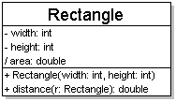
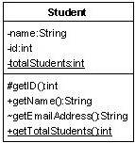
Diagram of one class
class name in top of box
  write <<interface>> on top of interfaces' names
  use italics for an abstract class name
attributes (optional)
  should include all fields of the object
operations / methods (optional)
  may omit trivial (get/set) methods
    but don't omit any methods from an interface!
  should not include inherited methods

Slide 10
Class attributes
attributes (fields, instance variables)
  visibility name : type [count] = default_value
  visibility: + public
  # protected
  - private
  ~ package (default)
  / derived
  underline static attributes
  derived attribute: not stored, but can
  be computed from other attribute values
  attribute example:
  - balance : double = 0.00

Slide 11
Class operations / methods
operations / methods
  visibility name (parameters) : return_type
  visibility: + public
  # protected
  - private
  ~ package (default)
  underline static methods
  parameter types listed as (name: type)
  omit return_type on constructors and
  when return type is void
  method example:
  + distance(p1: Point, p2: Point): double

Slide 12
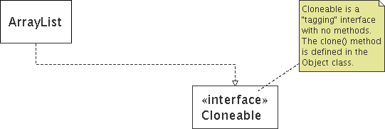
Comments
represented as a folded note, attached to the appropriate class/method/etc by a dashed line

Slide 13
Relationships between classes
generalization (an inheritance relationship)
  inheritance between classes
  interface implementation
association (a usage relationship)
  dependency
  aggregation
  composition

Slide 14
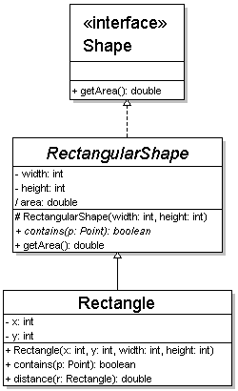
Generalization relationships
generalization (inheritance) relationships
  hierarchies drawn top-down with arrows pointing upward to parent
  line/arrow styles differ, based on whether parent is a(n):
    class:
    solid line, black arrow
    abstract class:
    solid line, white arrow
    interface:
    dashed line, white arrow
  we often don't draw trivial / obvious generalization relationships, such as drawing the Object class as a parent

Slide 15
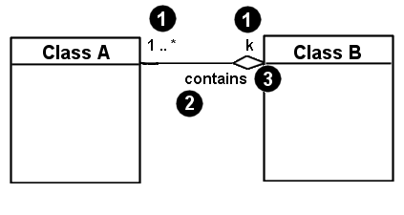
Associational relationships
associational (usage) relationships
  1. multiplicity (how many are used)
    * ⇒ 0, 1, or more
    1 ⇒ 1 exactly
    2..4 ⇒ between 2 and 4, inclusive
    5..* ⇒ 5 or more
  2. name (what relationship the objects have)
  3. navigability (direction)

Slide 16
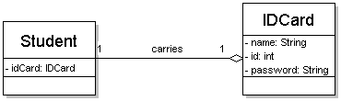
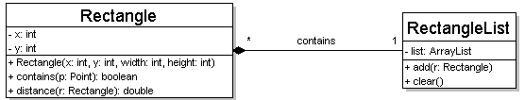
Multiplicity of associations
one-to-one
  each student must carry exactly one ID card
one-to-many
  one rectangle list can contain many rectangles

Slide 17
Association types
Car
1
1
aggregation
aggregation: "is part of"
  symbolized by a clear white diamond
composition: "is entirely made of"
  stronger version of aggregation
  the parts live and die with the whole
  symbolized by a black diamond
dependency: "uses temporarily"
  symbolized by dotted line
  often is an implementation
  detail, not an intrinsic part of
  that object's state
Engine
Book
composition
1
*
Page
dependency
Lottery
Ticket
Random

Slide 18
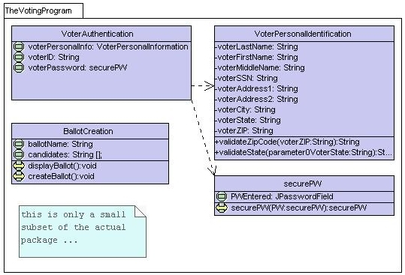
Class diagram example 1

Slide 19
Class diagram example 2
Multiplicity
Customer
1
Simple
Aggregation
Class
Abstract
Class
Rental Invoice
Rental Item
1..*
1
0..1
Composition
Simple
Association
Generalization
Checkout Screen
DVD Movie
VHS Movie
Video Game

Slide 20
Class diagram example 3
StudentBody
Student
1
100
- firstName : String
- lastName : String
- homeAddress : Address
- schoolAddress : Address
+ main (args : String[])
+ toString() : String
Address
- streetAddress : String
- city : String
- state : String
- zipCode : long
+ toString() : String

Slide 21
Tools for creating UML diags.
Violet (free)
  http://horstmann.com/violet/
Rational Rose
  http://www.rational.com/
Visual Paradigm UML Suite (trial)
  http://www.visual-paradigm.com/
  (nearly) direct download link:
  http://www.visual-paradigm.com/vp/download.jsp?product=vpuml&edition=ce
(there are many others, but most are commercial)

Slide 22
UML class diagram exercise
Let's draw a UML class diagram for the poker game we discussed earlier in class. Be sure to include the relationships between classes, both generalization and associational.

